Slide 1
Collection of 36 Articles by Peter Friedman
Liberalism, the United States & The Middle East
Connecting the Dots Between Them!
Introduction……WHAT IS WISDOM?
Prelude………...THE DIFFERENCE BETWEEN LIBERALS & CONSERVATIVES
Chapter – 1…..ORIGIN OF THE STATE OF ISRAEL
Chapter – 2.….NEW DEAL, OLD DEAL, BAD DEAL!
Chapter – 3.….ISLAM FALSE
Chapter – 4.….ISLAM AND THE MILGRAM EXPERIMENT
Chapter – 5.….BARACK HUSSEIN OBAMA AND HIS MIDDLE EAST CONNECTION
Chapter – 6.….THE ARAB-ISRAELI CONFLICT
Chapter – 7.….REFORM AMERICAN JEWS AND ISRAEL
Chapter – 8…..THE NEUROSES OF THE AMERICAN JEW
Chapter – 9.….THE TRIBALIZATION OF AMERICA
Chapter – 10…OBAMA’S SIMPLE CREED
Chapter – 11…THE PSYCHOLOGY OF MUSLIM ATROCITY
Chapter – 12…A WARNING TO AMERICAN JEWS
Chapter – 13…JEWS AND THE FEDERAL RESERVE
Chapter – 14…THOMAS JEFFERSON AND THE MUSLIMS
Chapter – 15…HOMELAND SECURITY AND THE KORAN LEVEL 1 CRIMES
Chapter – 16…AMERICAN CONCENTRATION CAMP GUARDS
Chapter – 17…“WHAT DO YOU WANT FROM ME?”
Chapter – 18…HOW THE AMERICAN ECONOMY IS SUPPOSED TO WORK
Chapter – 19…OBAMA AND THE MORLOCKS!
Chapter – 20…THE AMERICAN BIRTH DEFECT “THE STAIN OF SLAVERY”
Chapter – 21…THE TREASON OF OBAMA & CLINTON “Sleeping with the Enemy!”
Chapter – 22…INTERFAITH “DISCOURSE” – RITUAL SUICIDE!
Chapter – 23…ISLAM AND IQ!
Chapter – 24…“RELIGIOUSLY AGGRAVATED HARASSMENT”
Chapter – 25…“Defense Production Act of 1950” HITLER, MUSSOLINI, STALIN, MAO, OBAMA!
Chapter – 26…WHY MUSLIMS HATE JEWS!
Chapter – 27…THE ROOTS OF MY ANTI-SEMITISM!
Chapter – 28…THE DEATH OF HONOR
Chapter – 29…BARACK OBAMA FOR BETTER OR WORSE, FOR RICHER OR POORER….THE RESHAPING OF AMERICA
Chapter – 30…“THE RIGHT OF THE PEOPLE TO KEEP AND BEAR ARMS SHALL NOT BE INFRINGED”
Chapter – 31…“I APOLOGISE TO CHRISTIANS!”
Chapter – 32…MUSLIM PROPAGANDA
Chapter – 33…THE AMERICAN EXPERIMENT MAY BE OVER!
Chapter – 34…“IT’S THE CULTURE STUPID!” The American Narrative v. the Islamic Narrative
Chapter – 35…“ISLAM – AMERICA’S CANCER?”
Chapter – 36…THE ISLAMIC STATE OF IRAQ & SYRIA “ISIS” “MOHAMMED’S ISLAM” IS PURE ISLAM!
CD-PDF Format…....... $ 10

Slide 2
Which do you want?

Slide 3
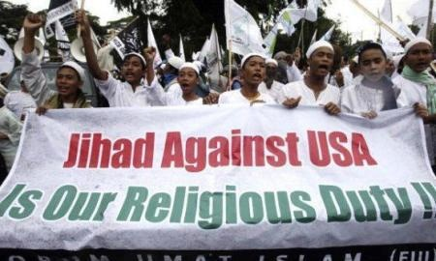
The Muslim Invasion of America
PETER M. FRIEDMAN
www.IslamThreat.com
Quest For World Domination
A CONSPIRACY TO CHANGE THE
DEMOGRAPHIC OF AMERICA!
A TICKING TIMEBOMB!

Slide 4
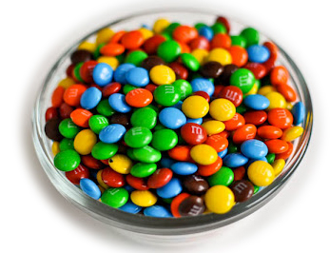
How many Muslims should we let in?
You have a bowl of 100 M&M’s
Only 1 of the M&Ms has arsenic in it
How many do you want to eat?

Slide 5
The Muslim Invasion!
Here’s how they’re doing it!
The mission in America of the Muslim Brotherhood is to destroy Western Civilization “FROM WITHIN”
“CIVILIZATION JIHAD”
By changing DEMOGRAPHICS ( 1 to 8 or More)
Changing LEGAL SYSTEMS through appointments
EMBEDDING MUSLIMS in ALL ASPECTS OF AMERICAN SOCIETY

Slide 6
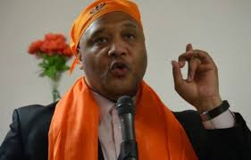
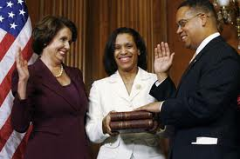
The Muslim Invasion!
To advance a quiet jihad, Muslims aggressively participate in ELECTIONS on LOCAL, STATE, FEDERAL, and SCHOOL LEVELS.
Their ultimate objective – GLOBAL SUBMISSION TO SHARIA.
HOW IS IT WORKING?
Andre
Carson
(D) IN
Keith
Ellison
(D) MN

Slide 7
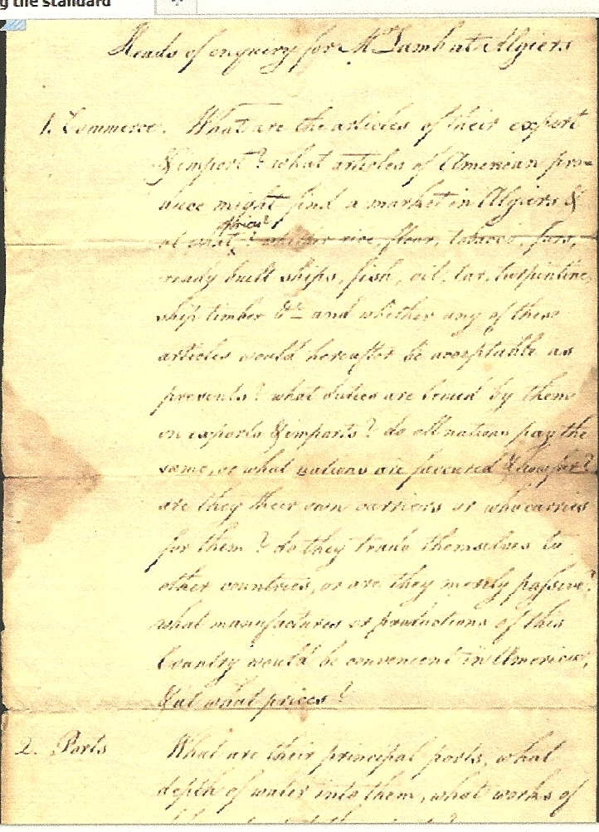
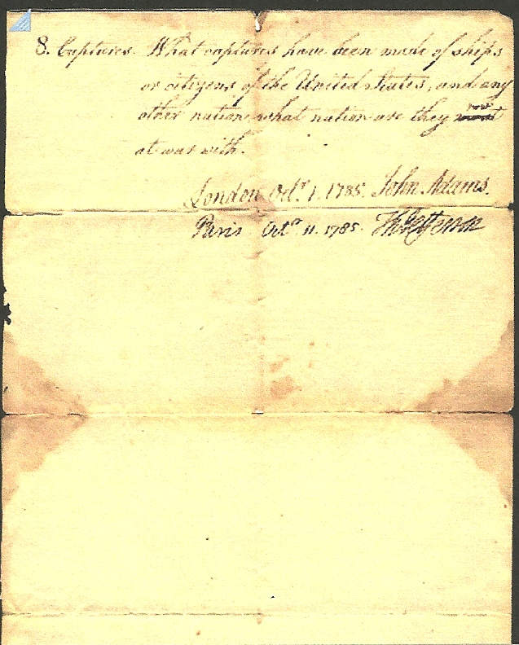
Jefferson & the Muslims!

Slide 8
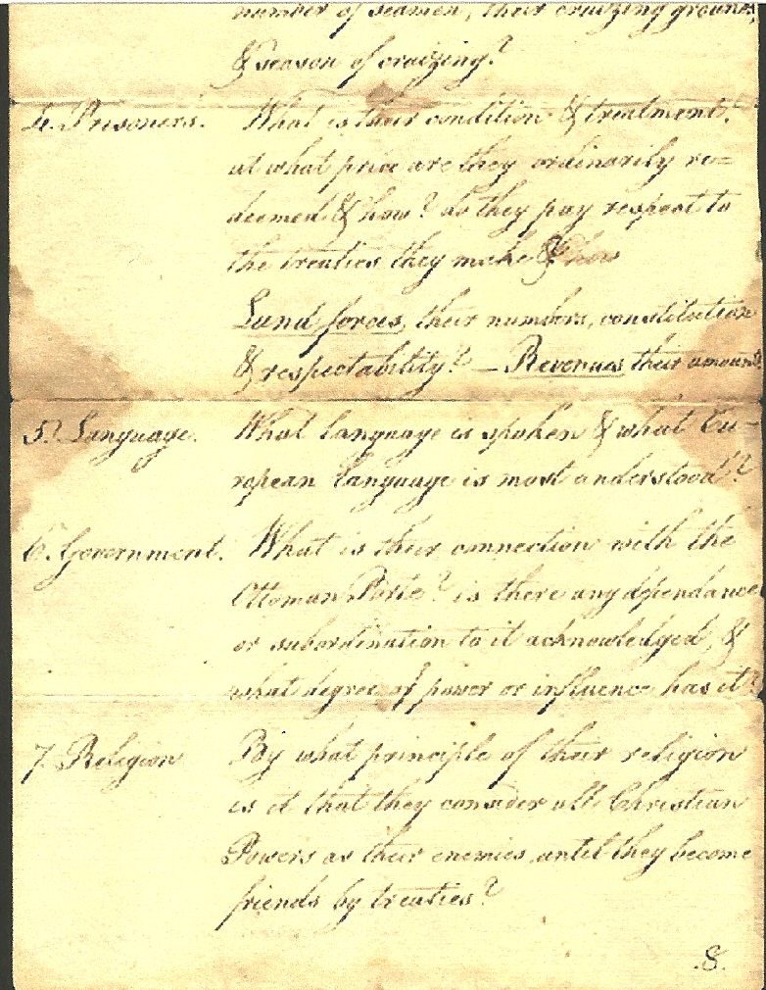
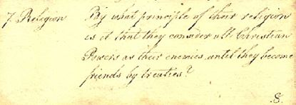
Jefferson & the Muslims!
7. Religion
“By what principles
of their religion [Islam]is it that they consider all Christian Powers as their “ENEMIES” until they become friends by treaty?”
Thomas Jefferson knew
NOTHING about Islam!

Slide 9
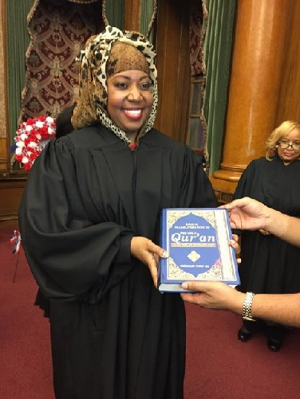
Sharia Court in Brooklyn!
First Muslim Woman Judge, Carolyn Walker, hand-picked by President Obama, sworn in as Judge of the 7th Municipal District Court, Brooklyn by holding the Holy Quran at Brooklyn Borough hall on December 10, 2015,

Slide 10
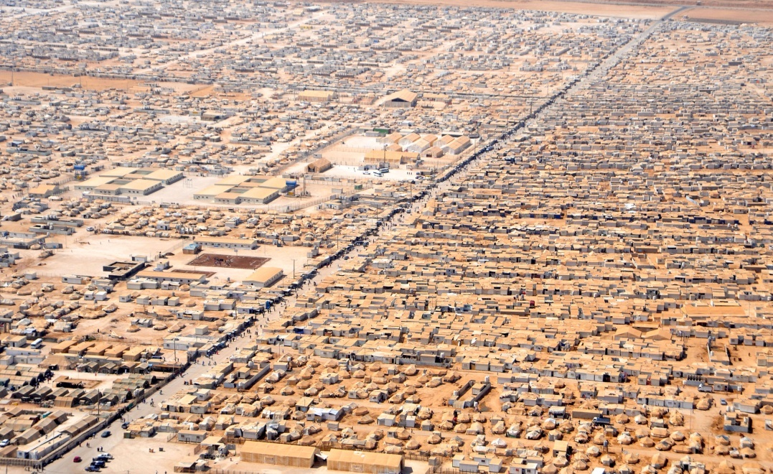
The Muslim Invasion!
This is how they are infiltrating.
WHY?
They don’t need to be relocated!
This is an encampment that exists now in
Zaatari for Syrian refugees in Jordan.
Germany
Austria
Hungary
Milan Italy
Sicily

Slide 11
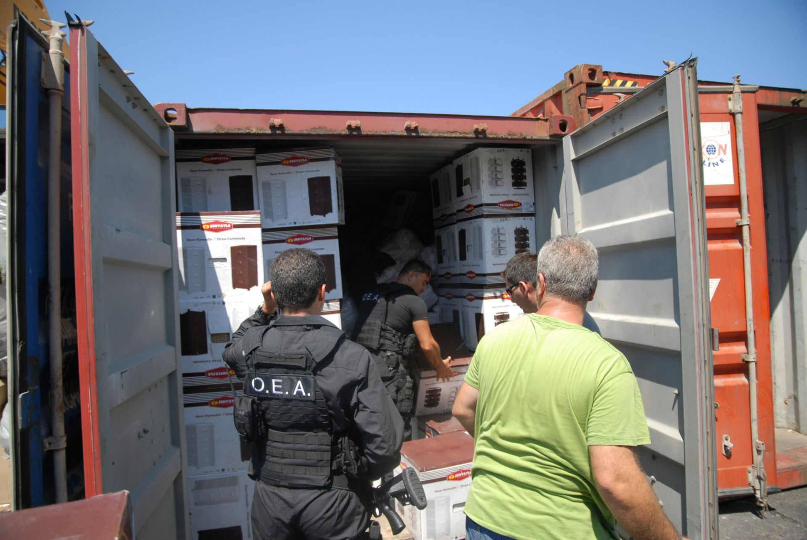
REFUGEE “FURNITURE”!

Slide 12
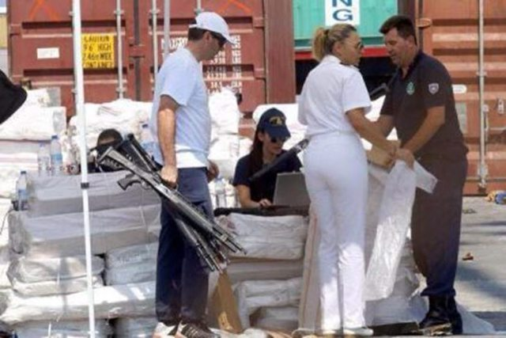
REFUGEE “FURNITURE”!

Slide 13
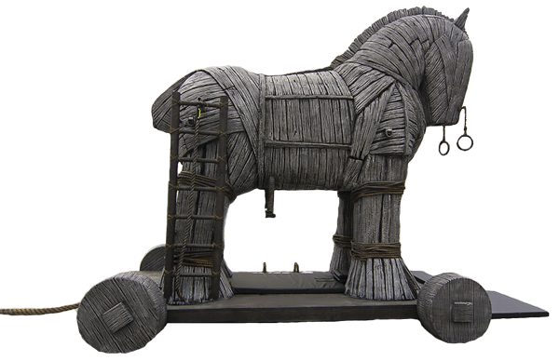
The Muslim Doctrine of Infiltration!
From Dar-ul-Islam to Dar-ul-Harb!
Muslim “IMMIGRATION” to America is now through:
Refugee Resettlement
Asylum Programs

Slide 14
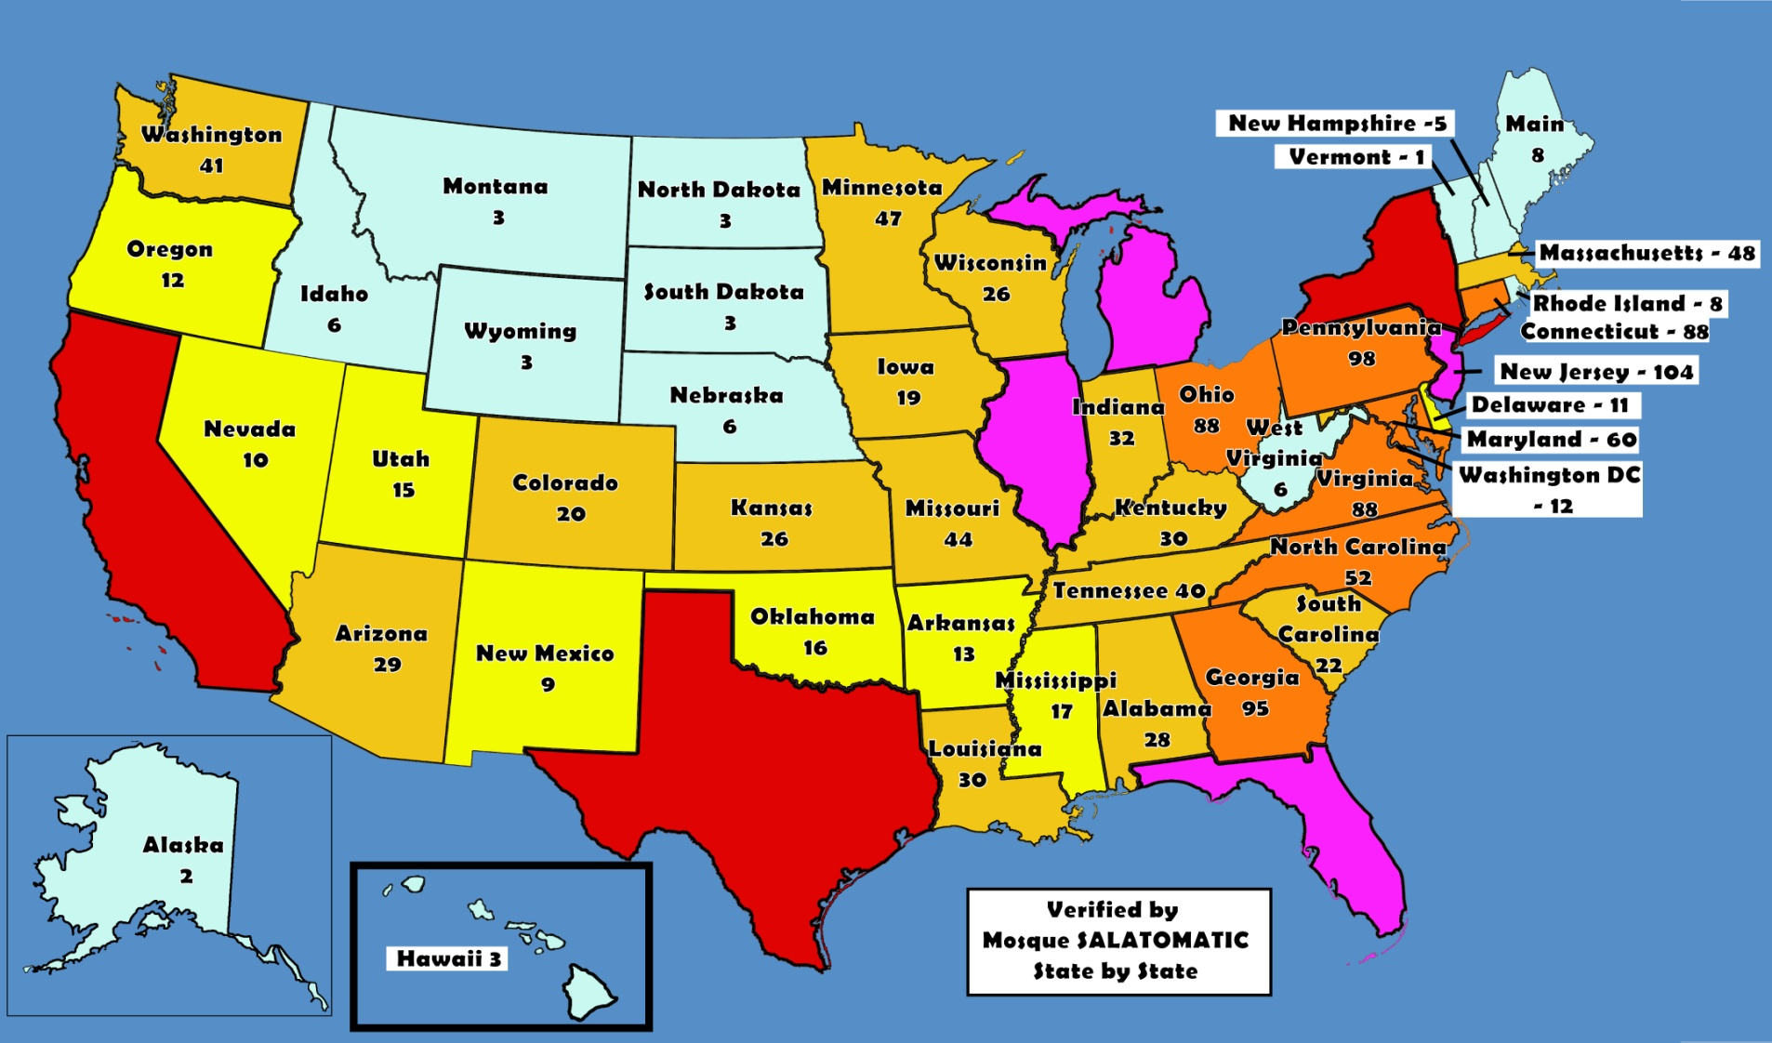
Muslim “infiltration” into America since 9-11!
MOSQUES IN AMERICA 2015
Michigan
139
New York 507
Illinois
200
California
525
Texas
302
0 -10
10 - 19
Florida
153
20 - 49
50 - 99
100 - 249
250 - 550

Slide 15
What does the Koran say?
[2.216] Fighting is enjoined on you…
Christians 60 million
Hindus 80 million
Buddhists 10 million
Africans 120 million
Total = 270 million

Slide 16
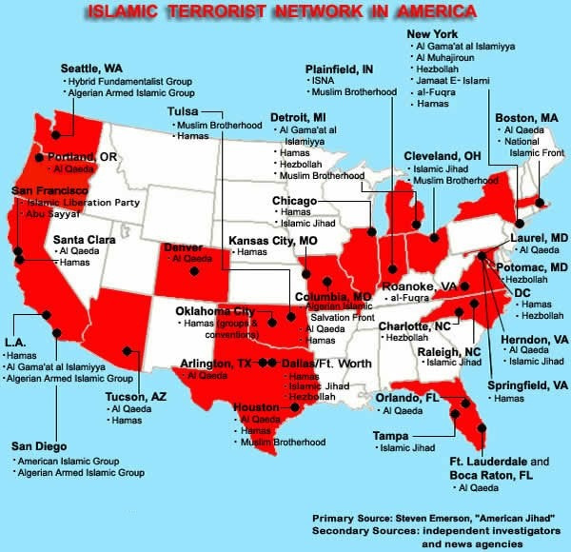
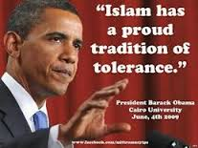
What does the Koran say?
[2.191] And kill them wherever you find them… such is the recompense of the unbelievers!
2002 - 03
270 MILLION KILLED SINCE 622AD!
4 in California
2 - Santa Clara
1 - LA
1 - San Diego

Slide 17
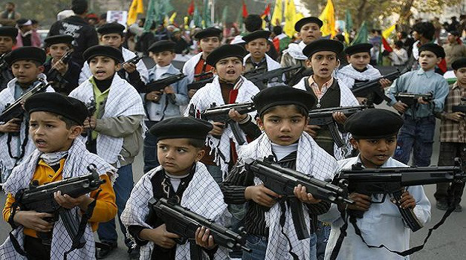
What does the Koran say?
[2.216] Fighting is enjoined on you...
“THE ORPHANS”
This is what they teach their 5 and 6 year old Children

Slide 18
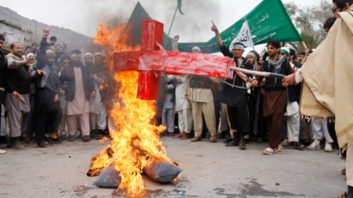
What does the Koran say?
[8.39] And fight with them until…religion should be only for Allah
“PERSECUTION of CHRISTIANS”

Slide 19
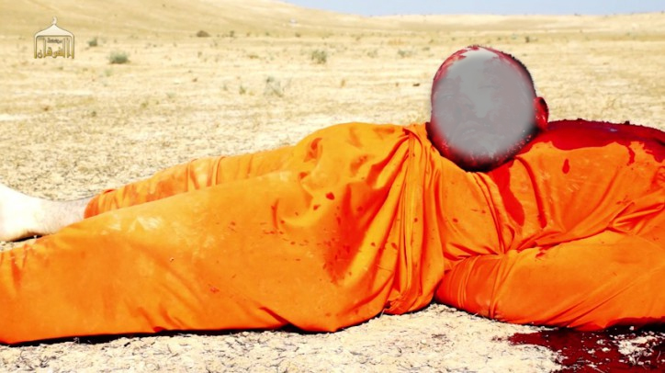
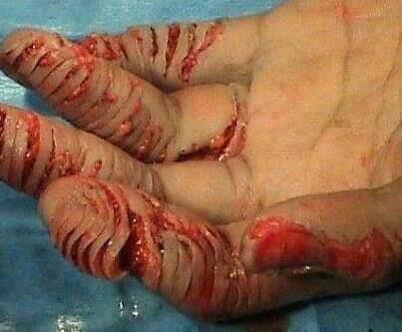
What does the Koran say?
[8.12] I will cast terror into the hearts of those who disbelieve. Therefore strike off their heads and strike off every fingertip of them.
“PUNISHMENT FOR READING
A BIBLE IN SAUDI ARABIA”

Slide 20
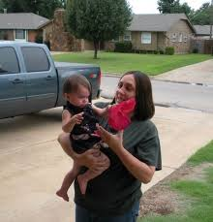
What does the Koran say?
[8.12] I will cast terror into the hearts of those who disbelieve. Therefore strike off their heads!

Slide 21
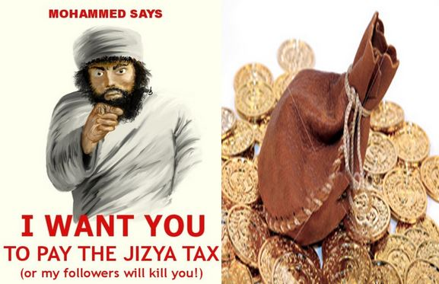
What does the Koran say?
[9.29] Fight those who do not believe in Allah…until they pay the tax in acknowledgment of superiority and they are in a state of subjection.

Slide 22
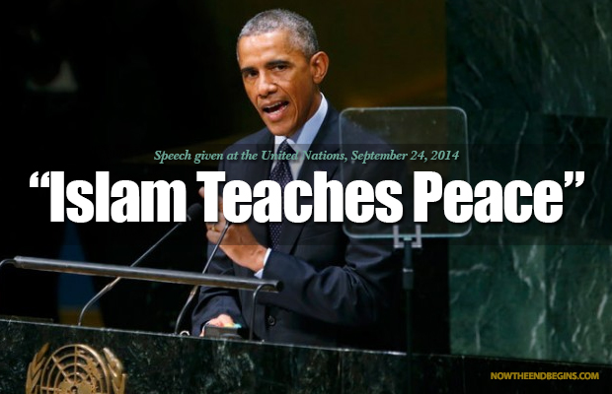
SERIOUSLY?

Slide 23
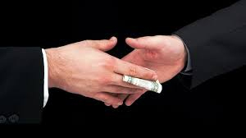
American Socialist Media!
BEWARE THE GOVERNMENT-MEDIA COMPLEX!

Slide 24
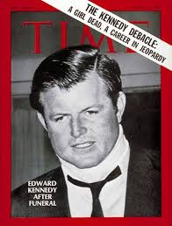
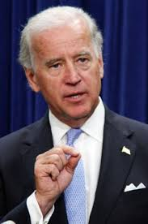
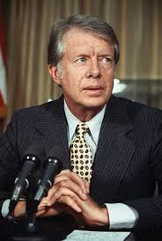
The Refugee Act of 1980
Because the DEMOCRATS decided by putting
more 3rd World immigrants on welfare, they would create more DEMOCRAT VOTERS!
The 1980 Refugee Act was sponsored by
Ted Kennedy
and JOE BIDEN!
It was signed into law by JIMMY CARTER!
WHY?

Slide 25
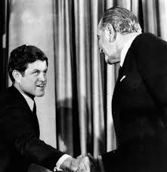
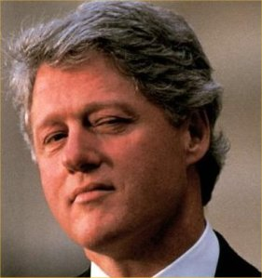
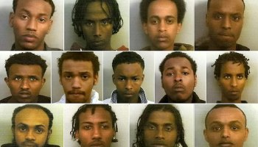
The Refugee Act of 1980
BILL CLINTON then imported THOUSANDS of SOMALIES into Minnesota and Arkansas putting them on welfare!
TED KENNEDY started the refugee flooding in 1965 under President JOHNSON with VIETNAMESE
That’s a FACT! Look it up!
CHILDREN OF THESE SOMALIES ARE NOW FIGHTING WITH ISIS!
That’s a FACT! Look it up!

Slide 26
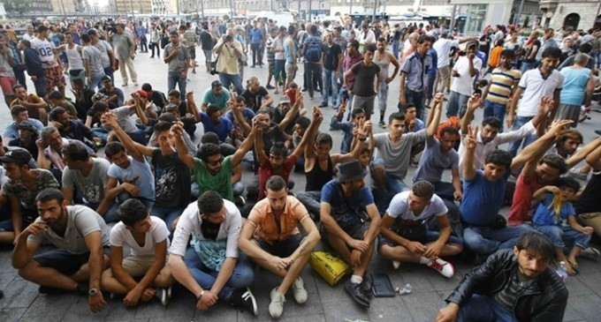
The Refugee Act of 1980
Obama’s first shipment of 10,000 Syrian Refugees due to arrive in New Orleans
Awaiting flights to the US
REFUGEES and ASSYLEES
immediately get
ALL FEDERAL BENEFITS
CASH
HOUSING
FOOD STAMPS
MEDICAL CARE
EMPLOYMENT
EDUCATION
LEGAL SERVICES

Slide 27
The GOLD CARD!

Slide 28
They get PRIVACY RIGHTS!

Slide 29
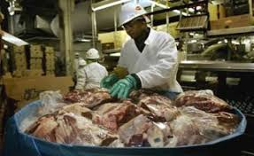
They get WORK PERMITS!
TYSON
CHICKEN
IN ARKANSAS

Slide 30
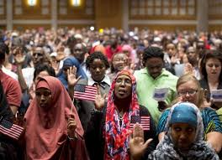
Then GREEN CARDS!

Slide 31
Refugee Admissions - 2015
Congress receives “THE REFUGEE REPORT” at the start of EACH YEAR:
Estimated number of Refugees
The Preferred STATES and CITIES
The Specific NGO Contractors (Only
Proposed Refugee ADMISSIONS
FOR
Fiscal Year 2015
Report to Congress
9 Approved!) to Settle Them!
DO THEY READ IT?
Did they read;
Obamacare
Iran-Nuclear

Slide 32
Refugee Admissions - 2015
“During FY 2013, 63 % of the refugees resettled in 12 states.
The majority were placed in;
10.7 %..TEXAS
9.1 %.... CALIFORNIA
6.6 %.... MICHIGAN
5.7 %.... NEW YORK
5.2 %.... FLORIDA
4.4 %.... ARIZONA
6383 REFUGEES ADMITTED TO CALIFORNIA IN 2013! b

Slide 33
Refugee Admissions - 2015
($ MILLIONS)
DEPARTMENT OF HOMELAND SECURITY
Refugee Processing $33
DEPARTMENT OF STATE
Refugee Admissions $418
DEPARTMENT OF HEALTH AND HUMAN SERVICES
Office of Refugee Resettlement
Refugee Resettlement $608
TOTAL $1,059 BILLION!

Slide 34
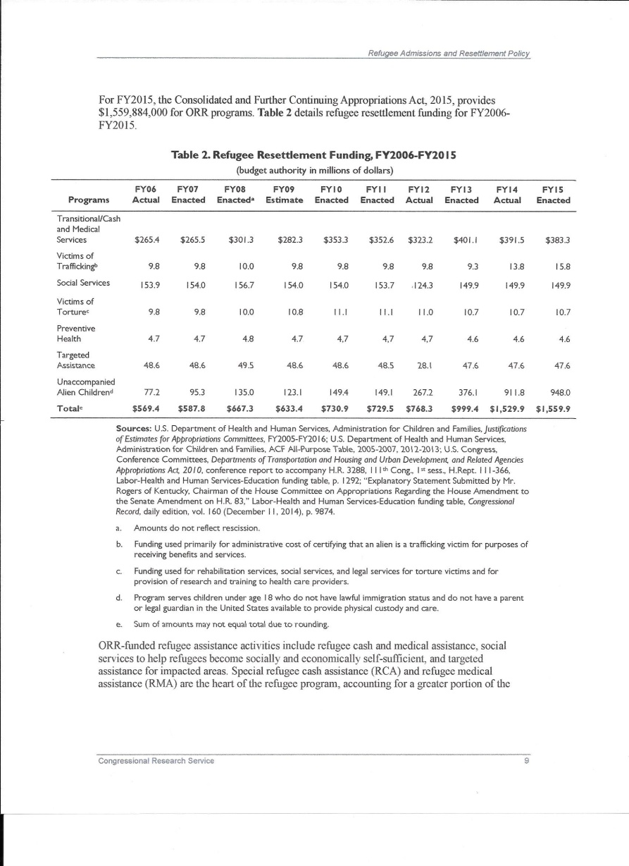
Congress knows!
THEY GET THE REPORT!
ALL THE
NUMBERS AND
INFORMATION IS HERE

Slide 35
Congress knows!
IN FY2013 WE ADMITTED MALE MUSLIM REFUGEES FROM THESE COUNTRIES:
COUNTRY AMT AGE
AFGHANISTAN ..…………………… 661 (23)
BHUTHAN …………………… 9134 (28)
BURMA ……..…………… 16299 (23)
IRAQ …….......………… 19488 (28)
SOMALIA ………….………… 7608 (22) SUDAN ………………….… 2160 (27)

Slide 36
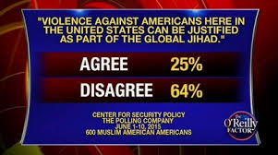
Muslim Terrorists in the US?
The FBI is way off!

Slide 37
Who is Running the Refugee Scam?
6 Religious Charities
Church World Service (CWS)
Hebrew Immigrant Aid Society (HIAS)
Episcopal Migration Ministries (EMM)
Lutheran Immigration and Refugee Services (LIRS)
United States Conference of Catholic Bishops (USCCB)
World Relief Corporation (WR)
3 Secular
Ethiopian Community Development Council (ECDC)
International Rescue Committee (IRC)
US Committee for Refugee and Immigrants (USCRI)

Slide 38
Follow the Money! It’s Billions!
The Church World Service (CWS) (Internal Revenue Form 990)
Total revenue $76,185,774
Govt. grants $45,431,781
Percent taxpayer funded: 60%
Top salary: $286,000
Ethiopian Community Development Council (ECDC) (Internal Revenue Form 990)
Total Revenue: $15,244,802
Govt. grants $14,609,687
Percent taxpayer funded: 96%
Top salary: $233,228

Slide 39
Follow the Money! It’s Billions!
Episcopal Migration Ministries (EMM)
NO FORM 990 Or publish their federal income in their annual report.
In 2012 audit revealed they received $17,365,325
NOW known as (Domestic and Foreign Missionary Society of the Protestant Episcopal Church of America)
Hebrew Immigrant Aid Society (HIAS) (Form 990 filed under HIAS, not the full name)
Total Revenue: $25,418,714
Govt. grants $15,426,116
Percent taxpayer funded: 61%
Top salary: $323,162

Slide 40
Follow the Money! It’s Billions!
International Rescue Committee (IRC) (Form 990 filed 2012)
Total Revenue: $456,122,865
Govt. grants $332,271.151
Percent taxpayer funded: 73%
Top salary: $485,321
United States Conference of Catholic Bishops (USCCB)
(Form 990 filed 2012)
Total Revenue: $39,205,548
Govt. grants $38,817,939
Percent taxpayer funded: 99%
Top salary: $289,192

Slide 41
Follow the Money! It’s Billions!
Lutheran Immigration & Refugee Services (LIRS) (Form 990 filed 2012)
Total Revenue: $43,563,804
Govt. grants $42,047,935
Percent taxpayer funded: 97%
Top salary: $ 214,237
World Relief Corporation (WR)
(Form 990 filed 2012)
Total Revenue: $56,842,649
Govt. grants $38,837,294
Percent taxpayer funded: 68%
Top salary: $211,651

Slide 42
Follow the Money! It’s Billions!
United States Conference of Catholic Bishops (USCCB)
RESETTLED THE LARGEST NUMBER OF REFUGEES IN THE US
Refugees are placed WITH NO STATE INPUT.
Total Revenue: $70,975,237
Govt. grants $69,534,230
Percent taxpayer funded: 98%
Top salary: WE HAVE NO IDEA

Slide 43
Follow the Money! It’s Billions!
THEY’RE DOING IT FOR THE MONEY

Slide 44
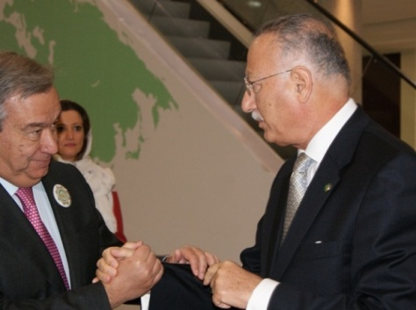
How are the Refugees Picked?
The United Nations picks OUR refugees.
U.N. High Commissioner for Refugees (UNHCR)
Antonio Guterres
Former Communist President of Portugal
Former President of Socialist International
Parent organization - Democratic Socialists of America! All DEMOCRAT members of Congress belong to the DSA, including BERNIE SANDERS!
NO CHRISTIANS are brought in resulting from the 2012 ASHGABHAT AGREEMENT with MUSLIM COUNTRIES!

Slide 45
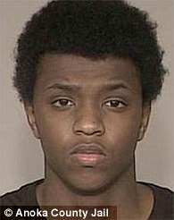
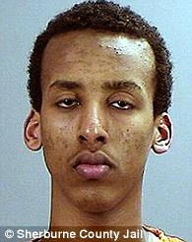
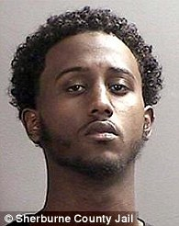
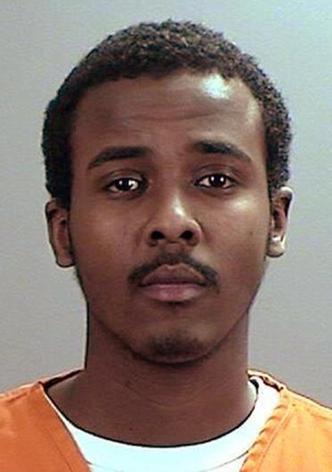
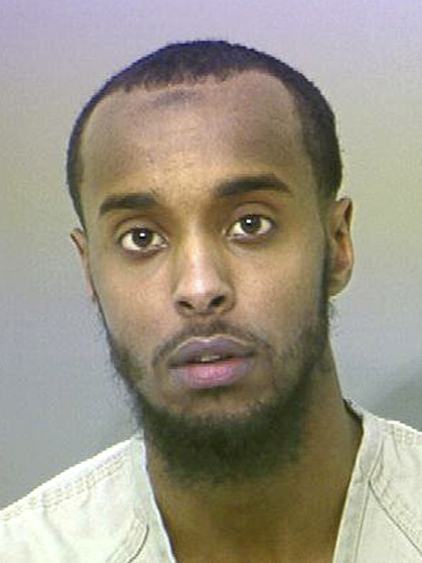
Do we have problems with any Asylees and refugees?
America's ENEMIES within:
Nearly 70 have been arrested in America over ISIS plots in the last 18 months. HERE ARE JUST A FEW!
Guilty: From left Zacharia Abdurahman, Hamza Ahmed and Hanad Musse have all admitted conspiracy to provide material support and attempting to provide material support to a foreign terrorist organization.
21-year-old Abdurahman Yasin Daud, who was born at a refugee camp in Kenya
Ohio - Abdirahman Sheik Mohamud, 23, trained in Syria with weapons and explosives

Slide 46
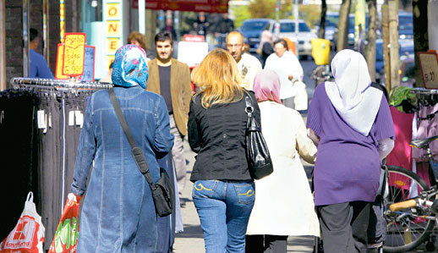
Preferred Communities Impact on YOU and the Town You Live in.
In the latest annual report to Congress, 2015, is a list of “PREFERRED CITIES”.
California is a “Preferred State”!
So which are the “PREFERRED CITIES” in California?
The Top Four are:
Sacramento
San Diego
Modesto
Who do you think is the fourth?

Slide 47
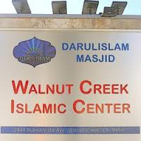
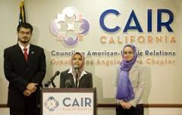
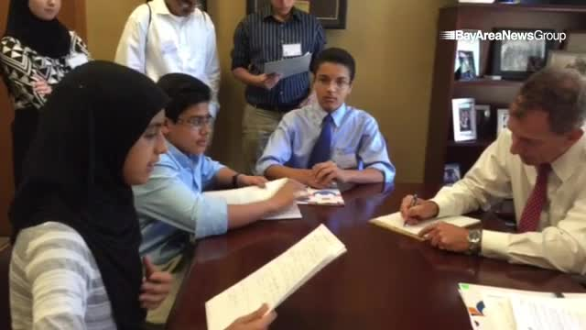
Preferred Communities Impact on YOU and the Town You Live in.
“Walnut Creek!
1855 Olympic Blvd., Ste. 200 Walnut Creek, CA 94596 Phone: (925) 927-2000 Fax: (925) 927-3131

Slide 48
Who is Supporting the Scam?
100 American Mayors – ALL DEMOCRATS!
Here are the cities in California whose mayors are
DEMANDING more MUSLIM refugees:
Los Angeles Richmond
Santa Monica Sacramento
Bell San Francisco
Long Beach San Jose
Oakland West Covina
www.citiesforaction.us

Slide 49
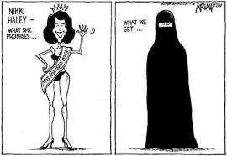
Who is Supporting the Scam?
Who is the ONLY Republican elected official Supporting the SCAM?
Nikki Haley of South Carolina! She is demanding more of Muslim Refugees?

Slide 50
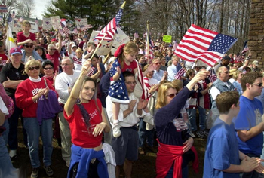
Pockets of Resistance!
(OIC) met in Lancaster, PA, to address “POCKETS OF RESISTANCE” to Muslim refugee resettlement.
They want to STOP us from pushing back!
They formed “Welcoming America”.
They work in TOTAL SECRECY
No announcements of refugee arrival!
They got help from GEORGE SOROS
Run by “George Soros” “Four Freedoms Fund”.
U.S. taxpayers foot the bill.
Google “Four Freedoms Fund”, it takes you to “NEO”.
See how well organized they are!

Slide 51
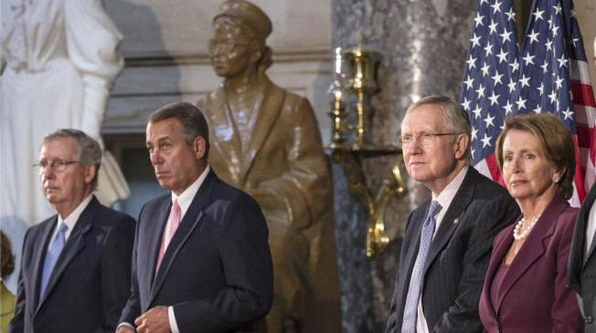
Both Parties are Doing It!
This is NOT Democrat vs. Republican! Both parties are after the MONEY and VOTES generated by refugee resettlement!

Slide 52
What can we do?
Push back on demands made by Muslim groups.
STOP new Mosques, Muslim Cemeteries or demands
for Halal food in our schools and prisons!
Protest loudly and often! They do it so must we!!
Use social media, write blogs, use Twitter, and Facebook.
Ask questions and state facts. GET INVOLVED!!
Form groups because you are more effective in numbers.
Speak out loudly to your City Council, do it again and again! They have to listen if it’s not just one person.

Slide 53
Questions to ask elected officials!
How many refugees would be brought into our Town?
How much Taxpayer support is involved? 80 - 90 - 100 %
Is there Federal-funded subsidized housing.
How will this affect our hospitals, schools and increasing the homeless community?
How long will they be entitled to WELFARE? Will a flood overload the local welfare system? (It’s OUR money!)
Will they WORK and WHERE? (Taking American jobs?)
Can we STOP the FLOW to our city if it becomes overloaded?
Will the Muslims assimilate, or just form another Dearborn, Michigan, a breeding ground for terrorists!!!

