Slide 1
https://www.datafiles.samhsa.gov/

Slide 2
Results from the 2020 National Survey on Drug Use and Health: Graphics from the Key Findings Report
Center for Behavioral Health Statistics and Quality
Substance Abuse and Mental Health Services Administration
U.S. Department of Health and Human Services
https://view.officeapps.live.com/op/view.aspx?src=https%3A%2F%2Fwww.samhsa.gov%2Fdata%2Fsites%2Fdefault%2Ffiles%2Freports%2Frpt35325%2F2020NSDUHFFRSlides090821.pptx&wdOrigin=BROWSELINK

Slide 3
Past Year Marijuana Use: Among People Aged 12 or Older; 2002-2020
FFR1.11
Age | 2002 | 2003 | 2004 | 2005 | 2006 | 2007 | 2008 | 2009 | 2010 | 2011 | 2012 | 2013 | 2014 | 2015 | 2016 | 2017 | 2018 | 2019 | 2020
12 or Older | 11.0 | 10.6 | 10.6 | 10.4 | 10.3 | 10.1 | 10.4 | 11.4 | 11.6 | 11.5 | 12.1 | 12.6 | 13.2 | 13.5 | 13.9 | 15.0 | 15.9 | 17.5 | 17.9
12 to 17 | 15.8 | 15.0 | 14.5 | 13.3 | 13.2 | 12.5 | 13.1 | 13.7 | 14.0 | 14.2 | 13.5 | 13.4 | 13.1 | 12.6 | 12.0 | 12.4 | 12.5 | 13.2 | 10.1
18 to 25 | 29.8 | 28.5 | 27.8 | 28.0 | 28.1 | 27.5 | 27.8 | 30.8 | 30.0 | 30.8 | 31.5 | 31.6 | 31.9 | 32.2 | 33.0 | 34.9 | 34.8 | 35.4 | 34.5
26 or Older | 7.0 | 6.9 | 7.0 | 6.9 | 6.9 | 6.8 | 7.0 | 7.7 | 8.0 | 7.9 | 8.6 | 9.2 | 10.1 | 10.4 | 11.0 | 12.2 | 13.3 | 15.2 | 16.3

Slide 4
Past Year Alcohol Initiates: Among People Aged 12 or Older; 2002-2020
FFR1.22
Age | 2002 | 2003 | 2004 | 2005 | 2006 | 2007 | 2008 | 2009 | 2010 | 2011 | 2012 | 2013 | 2014 | 2015 | 2016 | 2017 | 2018 | 2019 | 2020
12 or Older | 3.9 | 4.1 | 4.4 | 4.3 | 4.4 | 4.6 | 4.5 | 4.6 | 4.7 | 4.7 | 4.6 | 4.6 | 4.7 | 4.8 | 4.6 | 4.9 | 4.9 | 4.9 | 4.1
12 to 17 | 2.6 | 2.6 | 2.7 | 2.7 | 2.7 | 2.7 | 2.6 | 2.7 | 2.5 | 2.6 | 2.4 | 2.4 | 2.3 | 2.4 | 2.3 | 2.3 | 2.4 | 2.3 | 1.8
18 to 25 | 1.2 | 1.4 | 1.5 | 1.4 | 1.6 | 1.7 | 1.7 | 1.8 | 2.0 | 2.0 | 1.9 | 2.1 | 2.2 | 2.2 | 2.2 | 2.4 | 2.4 | 2.4 | 2.1
26 or Older | 0.1 | 0.1 | 0.2 | 0.1 | 0.1 | 0.1 | 0.2 | 0.1 | 0.2 | 0.1 | 0.2 | 0.1 | 0.1 | 0.2 | 0.2 | 0.1 | 0.1 | 0.2 | 0.2

Slide 5
Past Year Marijuana Initiates: Among People Aged 12 or Older; 2002-2020
FFR1.23
Note: Estimates of less than 0.05 million round to 0.0 million when shown to the nearest tenth of a million.
Age | 2002 | 2003 | 2004 | 2005 | 2006 | 2007 | 2008 | 2009 | 2010 | 2011 | 2012 | 2013 | 2014 | 2015 | 2016 | 2017 | 2018 | 2019 | 2020
12 or Older | 2.2 | 2.0 | 2.1 | 2.1 | 2.1 | 2.1 | 2.2 | 2.4 | 2.4 | 2.6 | 2.4 | 2.4 | 2.6 | 2.6 | 2.6 | 3.0 | 3.1 | 3.5 | 2.8
12 to 17 | 1.4 | 1.2 | 1.3 | 1.1 | 1.2 | 1.2 | 1.2 | 1.3 | 1.3 | 1.4 | 1.3 | 1.2 | 1.2 | 1.2 | 1.2 | 1.2 | 1.3 | 1.4 | 1.0
18 to 25 | 0.7 | 0.7 | 0.7 | 0.7 | 0.7 | 0.8 | 0.8 | 1.0 | 0.9 | 1.1 | 1.0 | 1.0 | 1.1 | 1.0 | 1.0 | 1.3 | 1.2 | 1.2 | 1.1
26 or Older | 0.1 | 0.1 | 0.2 | 0.3 | 0.1 | 0.1 | 0.2 | 0.0 | 0.2 | 0.2 | 0.2 | 0.2 | 0.3 | 0.4 | 0.4 | 0.5 | 0.5 | 0.9 | 0.7

Slide 7
Major Depressive Episode (MDE) and MDE with Severe Impairment in the Past Year: Among Youths Aged 12 to 17; 2004-2020
FFR1.30
N/A = not available.
MDE Status | 2004 | 2005 | 2006 | 2007 | 2008 | 2009 | 2010 | 2011 | 2012 | 2013 | 2014 | 2015 | 2016 | 2017 | 2018 | 2019 | 2020
MDE | 9.0 | 8.8 | 7.9 | 8.2 | 8.3 | 8.1 | 8.0 | 8.2 | 9.1 | 10.7 | 11.4 | 12.5 | 12.8 | 13.3 | 14.4 | 15.7 | 17.0
MDE with Severe Impairment | N/A | N/A | 5.5 | 5.5 | 6.0 | 5.8 | 5.7 | 5.7 | 6.3 | 7.7 | 8.2 | 8.8 | 9.0 | 9.4 | 10.0 | 11.1 | 12.0

Slide 8
Major Depressive Episode with Severe Impairment in the Past Year: Among Adults Aged 18 or Older; 2009-2020
FFR1.31
Age | 2009 | 2010 | 2011 | 2012 | 2013 | 2014 | 2015 | 2016 | 2017 | 2018 | 2019 | 2020
18 or Older | 4.0 | 4.2 | 4.2 | 4.5 | 4.3 | 4.3 | 4.3 | 4.3 | 4.5 | 4.7 | 5.3 | 6.0
18 to 25 | 5.2 | 5.2 | 5.2 | 5.8 | 5.7 | 6.0 | 6.5 | 7.0 | 8.5 | 8.9 | 10.3 | 12.1
26 to 49 | 4.8 | 4.7 | 5.2 | 5.1 | 4.9 | 4.6 | 4.9 | 4.7 | 5.0 | 5.3 | 6.1 | 6.5
50 or Older | 2.6 | 3.5 | 2.9 | 3.4 | 3.2 | 3.5 | 3.0 | 3.0 | 2.8 | 2.9 | 3.2 | 3.8

Slide 9
Serious Mental Illness in the Past Year: Among Adults Aged 18 or Older; 2008-2020
FFR1.32
Age | 2008 | 2009 | 2010 | 2011 | 2012 | 2013 | 2014 | 2015 | 2016 | 2017 | 2018 | 2019 | 2020
18 or Older | 3.7 | 3.7 | 4.1 | 3.9 | 4.1 | 4.2 | 4.1 | 4.0 | 4.2 | 4.5 | 4.6 | 5.2 | 5.6
18 to 25 | 3.8 | 3.3 | 3.9 | 3.8 | 4.1 | 4.2 | 4.8 | 5.0 | 5.9 | 7.5 | 7.7 | 8.6 | 9.7
26 to 49 | 4.8 | 4.9 | 5.2 | 5.0 | 5.2 | 5.3 | 4.9 | 5.0 | 5.3 | 5.6 | 5.9 | 6.8 | 6.9
50 or Older | 2.5 | 2.5 | 3.0 | 2.8 | 3.0 | 3.2 | 3.1 | 2.8 | 2.7 | 2.7 | 2.5 | 2.9 | 3.4

Slide 10
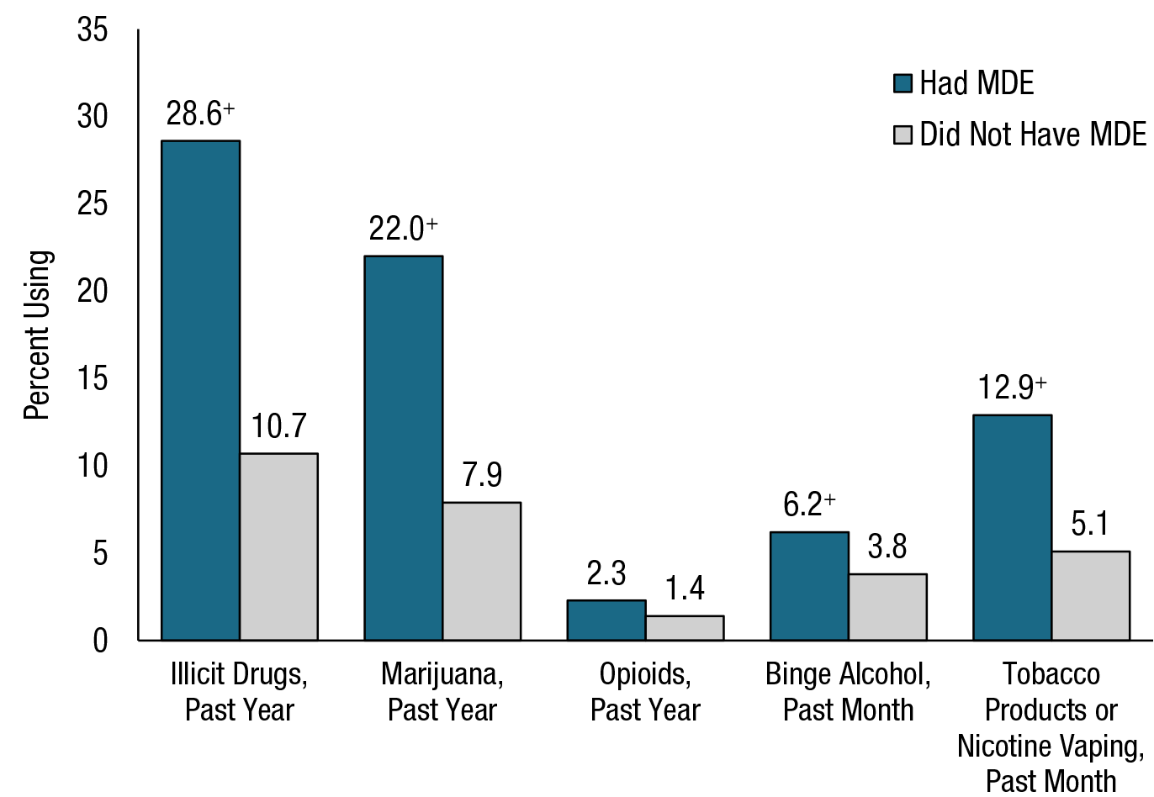
Substance Use: Among Youths Aged 12 to 17; by Past Year Major Depressive Episode (MDE) Status, 2020
FFR1.34
⁺ Difference between this estimate and the estimate for youths without MDE is statistically significant at the .05 level.
Note: Youth respondents with unknown MDE data were excluded.

Slide 11
Past Year Substance Use Disorder (SUD) and Any Mental Illness (AMI): Among Adults Aged 18 or Older; 2020
FFR1.35

Slide 12
Past Year Substance Use Disorder (SUD) and Serious Mental Illness (SMI): Among Adults Aged 18 or Older; 2020
FFR1.36

Slide 13
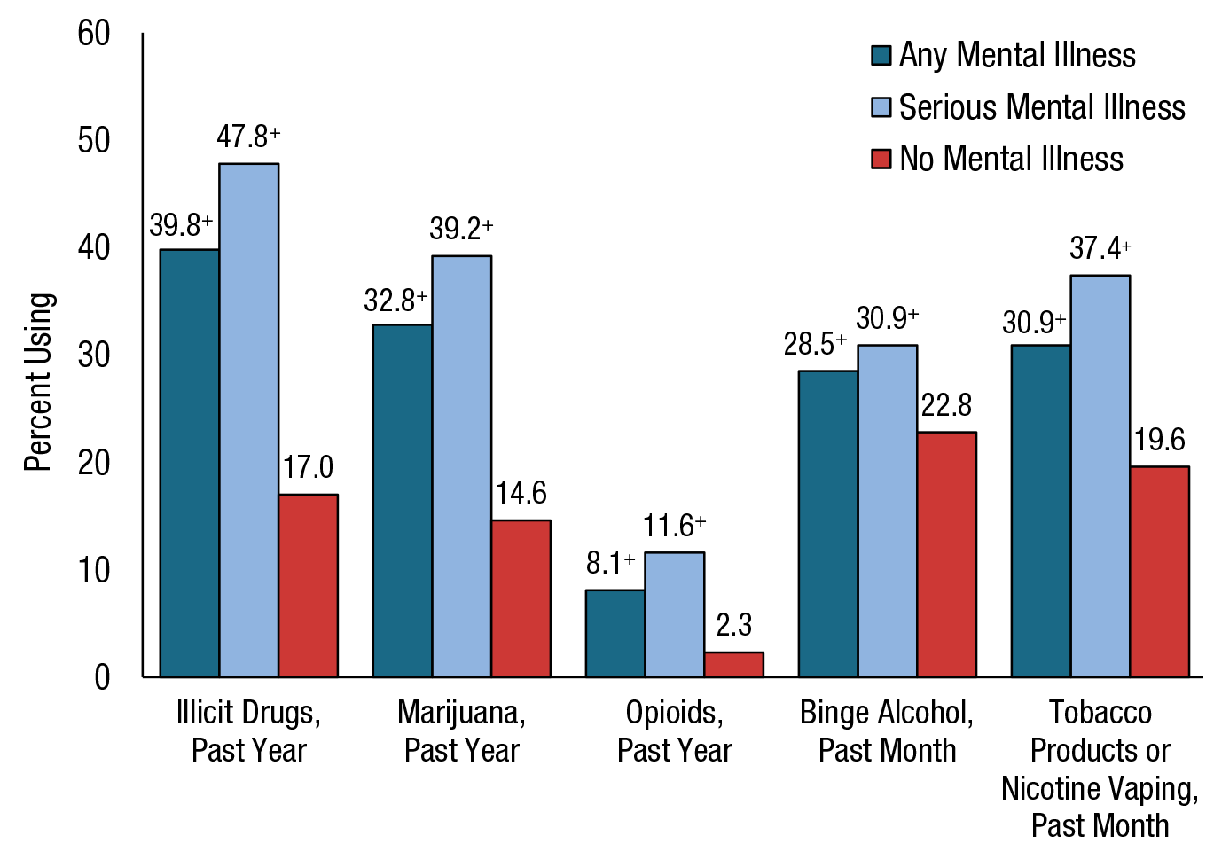
Substance Use: Among Adults Aged 18 or Older; by Mental Illness Status, 2020
FFR1.37
⁺ Difference between this estimate and the estimate for adults without mental illness is statistically significant at the .05 level.

Slide 14
Adults Aged 18 or Older with Serious Thoughts of Suicide, Suicide Plans, or Suicide Attempts in the Past Year; 2020
FFR1.38

Slide 15
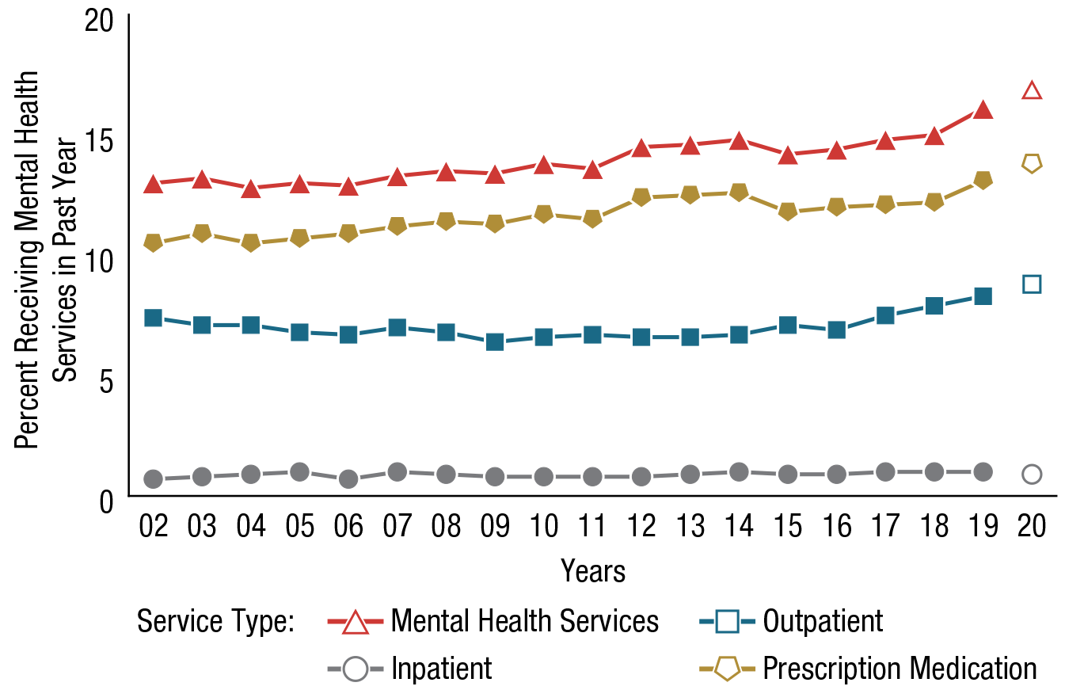
Type of Mental Health Services Received in the Past Year: Among Adults Aged 18 or Older; 2002-2020
FFR1.49
Note: Mental Health Services include any combination of inpatient or outpatient services or receipt of prescription medication.
Service Type | 2002 | 2003 | 2004 | 2005 | 2006 | 2007 | 2008 | 2009 | 2010 | 2011 | 2012 | 2013 | 2014 | 2015 | 2016 | 2017 | 2018 | 2019 | 2020
Mental Health Services | 13.0 | 13.2 | 12.8 | 13.0 | 12.9 | 13.3 | 13.5 | 13.4 | 13.8 | 13.6 | 14.5 | 14.6 | 14.8 | 14.2 | 14.4 | 14.8 | 15.0 | 16.1 | 16.9
Inpatient | 0.7 | 0.8 | 0.9 | 1.0 | 0.7 | 1.0 | 0.9 | 0.8 | 0.8 | 0.8 | 0.8 | 0.9 | 1.0 | 0.9 | 0.9 | 1.0 | 1.0 | 1.0 | 0.9
Outpatient | 7.4 | 7.1 | 7.1 | 6.8 | 6.7 | 7.0 | 6.8 | 6.4 | 6.6 | 6.7 | 6.6 | 6.6 | 6.7 | 7.1 | 6.9 | 7.5 | 7.9 | 8.3 | 8.8
Prescription Medication | 10.5 | 10.9 | 10.5 | 10.7 | 10.9 | 11.2 | 11.4 | 11.3 | 11.7 | 11.5 | 12.4 | 12.5 | 12.6 | 11.8 | 12.0 | 12.1 | 12.2 | 13.1 | 13.8

Slide 16
Receipt of Substance Use Treatment at a Specialty Facility and Mental Health Services in the Past Year: Among Adults Aged 18 or Older with Past Year Substance Use Disorder and Serious Mental Illness; 2020
FFR1.55
Note: Mental Health Services include any combination of inpatient or outpatient services or receipt of prescription medication.
MH = mental health; SU Tx = substance use treatment.
Note: The percentages do not add to 100 percent due to rounding.

